Slide 1
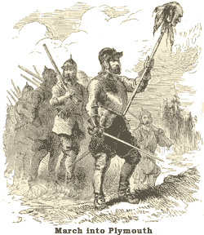
FOUNDATIONS OF AN AMERICAN IDENTITY
History 180 - 3

Slide 2
RECAP:
Last time we looked at the first permanent English settlements in the Americas, paying particular attention to the economic basis of each and each colony fulfilled its need for labor.
This time: This week we will examine the settlement of Puritans in New England during the 17th century, and then turn our attention to the transformations that took place in England’s colonies in North America during the 18th century

Slide 3
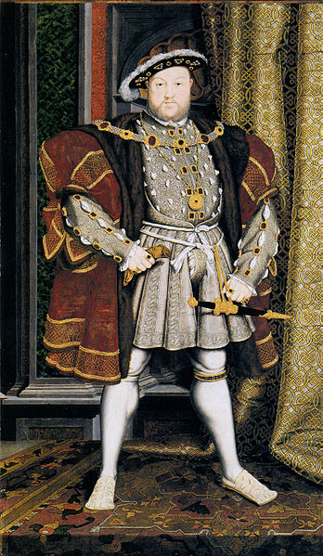
PROTESTANTISM AND THE CHURCH OF ENGLAND
Henry VIII ushered in an unusual Protestant Reformation in 1534.
People who wanted to purify the Church of England from its Catholic vestiges are known as Puritans.

Slide 4
MORE ON PURITANS
Attempt to resist Shakespearean concept of a “merrie England”
Used the Calvinist notion of “predestination”
1. work ethic (covenant of works)
2. group salvation
3. conversion of others

Slide 5
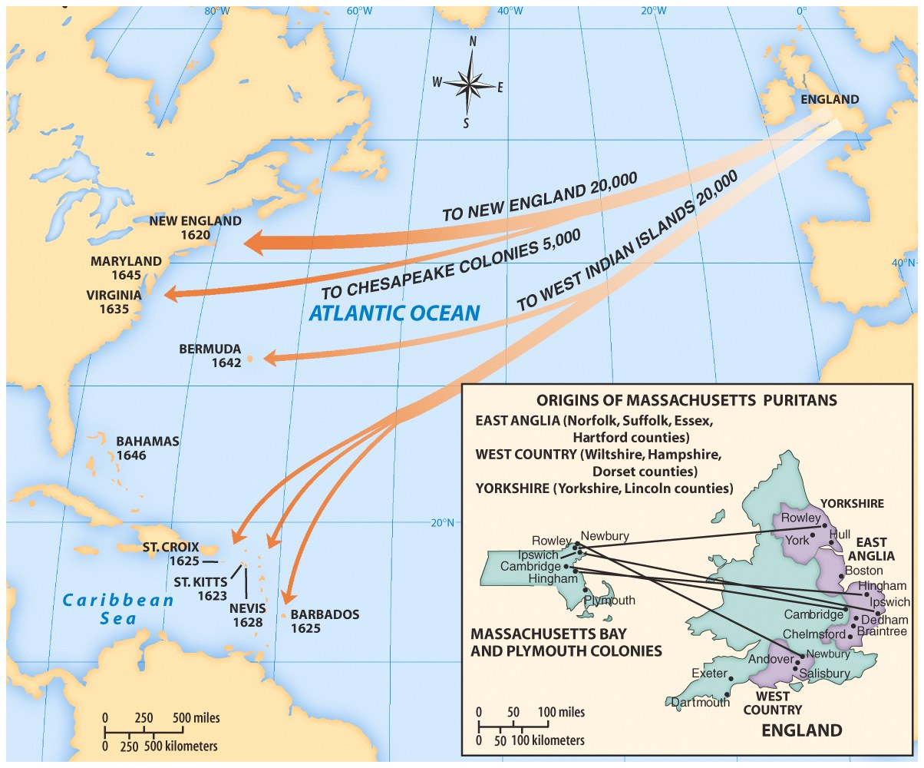
PURITAN MIGRATION, CIRCA 1620-1640
Puritan beliefs were central to the founding of Massachusetts, Connecticut and Rhode Island.
English fishermen had visited New England for decades, “A Paradise in these parts”

Slide 6
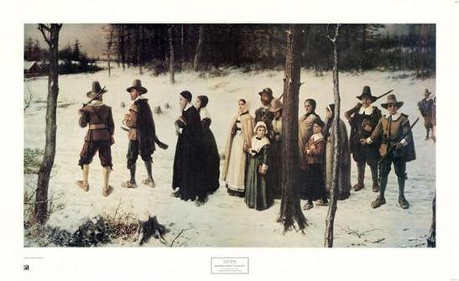
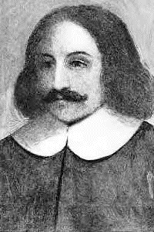
PURITAN SEPARATISTS (“SAINTS” OR “PILGRIMS”)
Soon to find themselves under the leadership of William Bradford, the Pilgrims landed at Plymouth Rock in 1620.

Slide 7
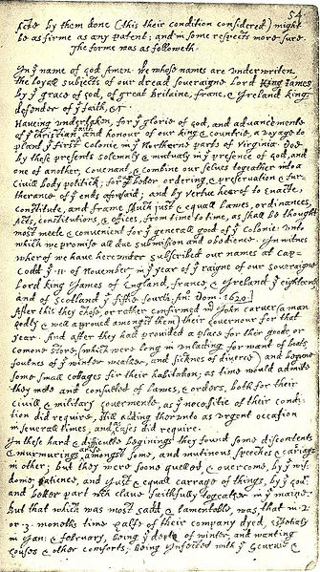
THE MAYFLOWER COMPACT
The pilgrim separatists established a self-rule that lasted until 1691.

Slide 8
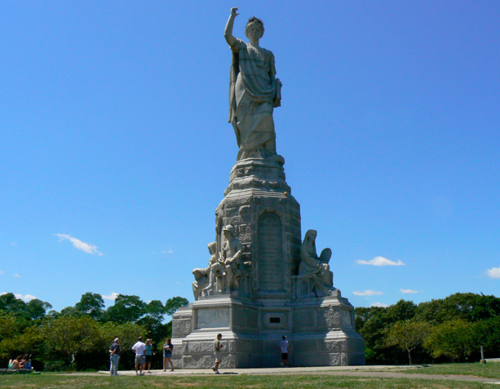
MONUMENT AT PLYMOUTH, MASSACHUSETTS

Slide 9
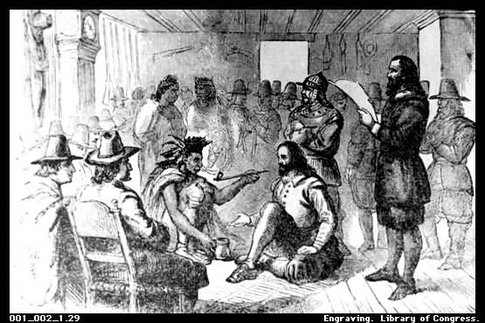
MASSASOIT AND THE WAMPANOAGS
The Mayflower colonists were met in Spring, 1621 by Samoset, and Squanto, two English-speaking Wampanoags.

Slide 10
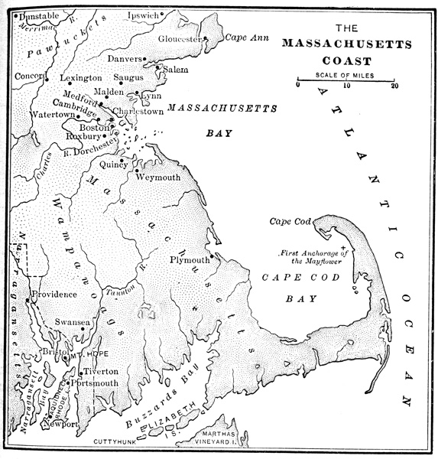
MASSACHUSETTS BAY COLONY
*Boston
*Plymouth

Slide 11
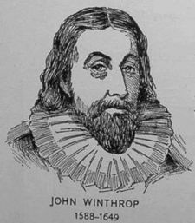
“A CITY UPON A HILL”
“For we must consider that we shall be as a city upon a hill. The eyes of all people are upon us. So that if we shall deal falsely with our God in this work we have undertaken, and so cause Him to withdraw His present help from us, we shall be made a story and a by-word through the world. “

Slide 12
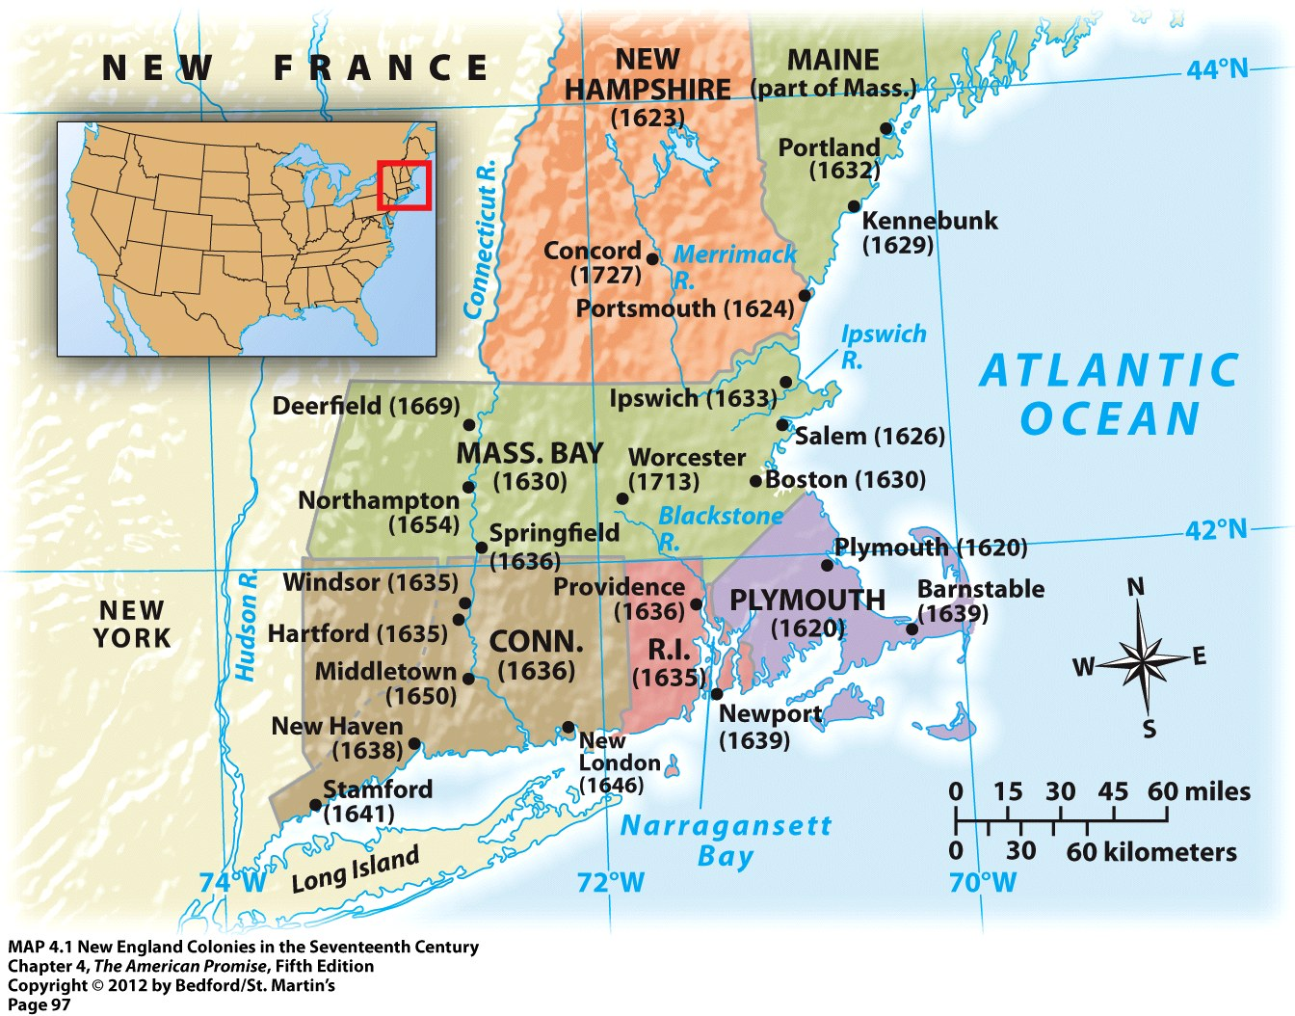

Slide 13
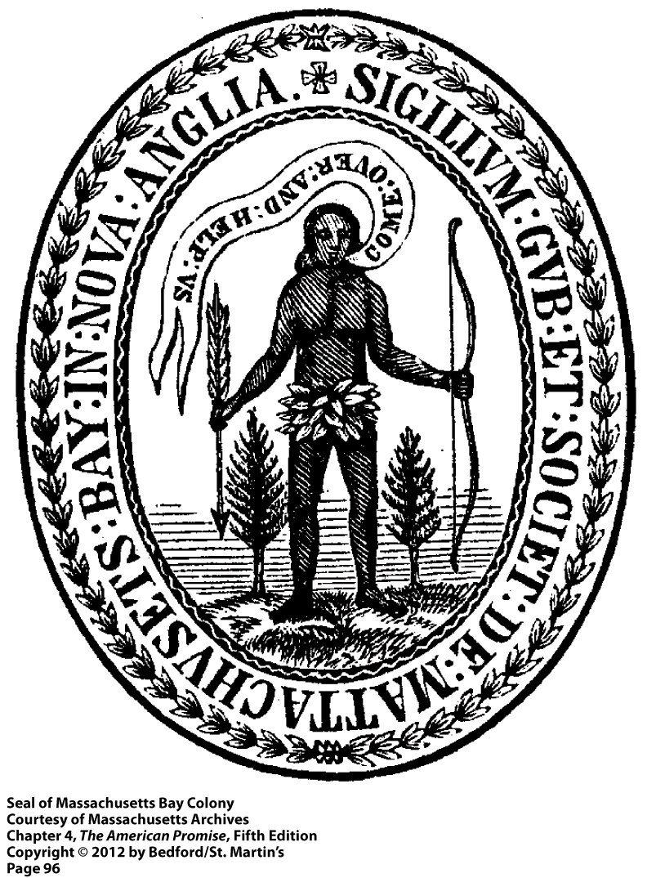
The Indian population of Massachusetts was low because many had been destroyed by Spanish diseases and warfare during the 16th century.

Slide 14
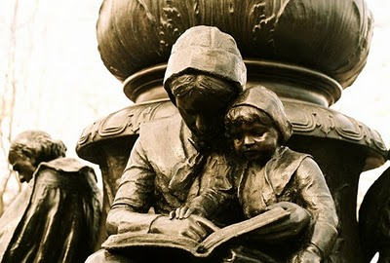
INTERLOCKING INSTITUTIONS OF FAMILY, CHURCH AND COMMUNITY
“Good Children Must
Fear God all day
Parents obey
No false thing say
by no sin stray
Love Christ always
In secret pray
Mind little play
Make no delay
In doing good”

Slide 15
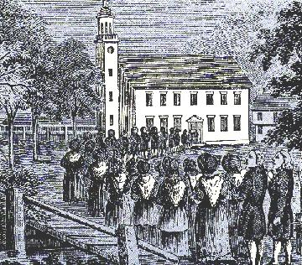
A PURITAN CHURCH
Puritans looked after one another, and looked in one on another.

Slide 16
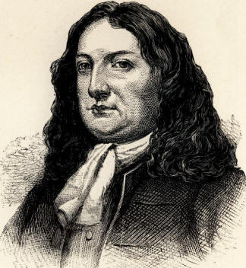
WILLIAM PENN 1644-1718

Slide 17
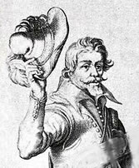
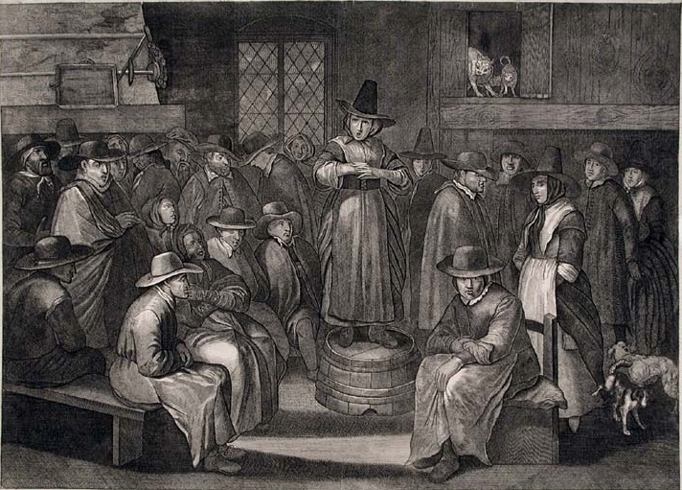
QUAKER MEETING
“The light within”
A “society of friends”
Egalitarian
Doffing of the hat
Men and women spiritually equal
Pacifist

Slide 18
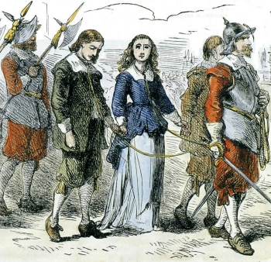
EXECUTION OF QUAKERS IN ENGLAND

Slide 19
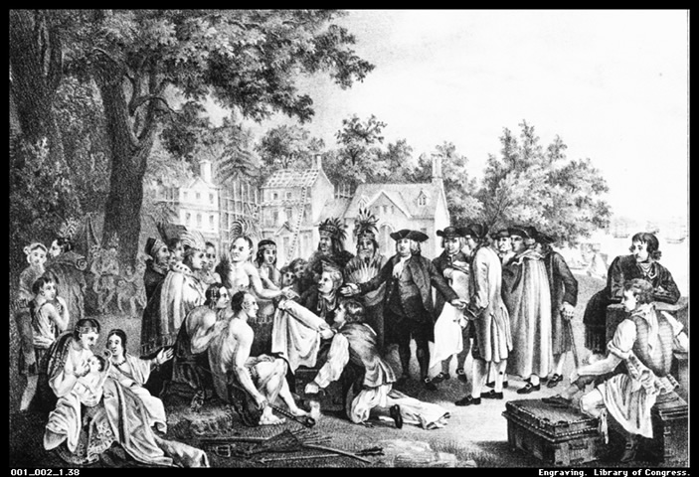
PENNSYLVANIA

Slide 20
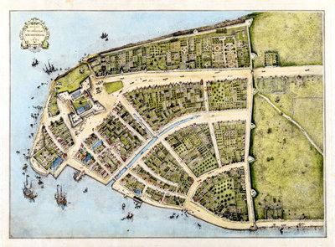
NEW AMSTERDAM
A Dutch settlement
in North America,
1614-1664
A Du

Slide 21
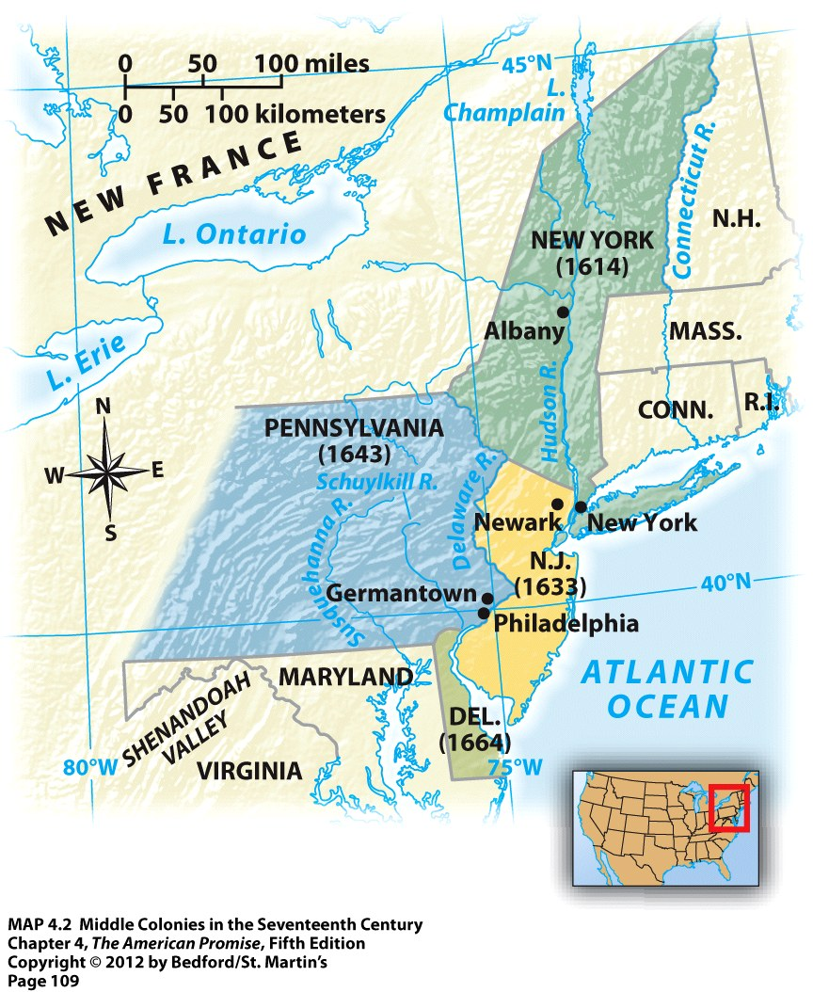
What was produced in
“the middle colonies?”

Slide 22
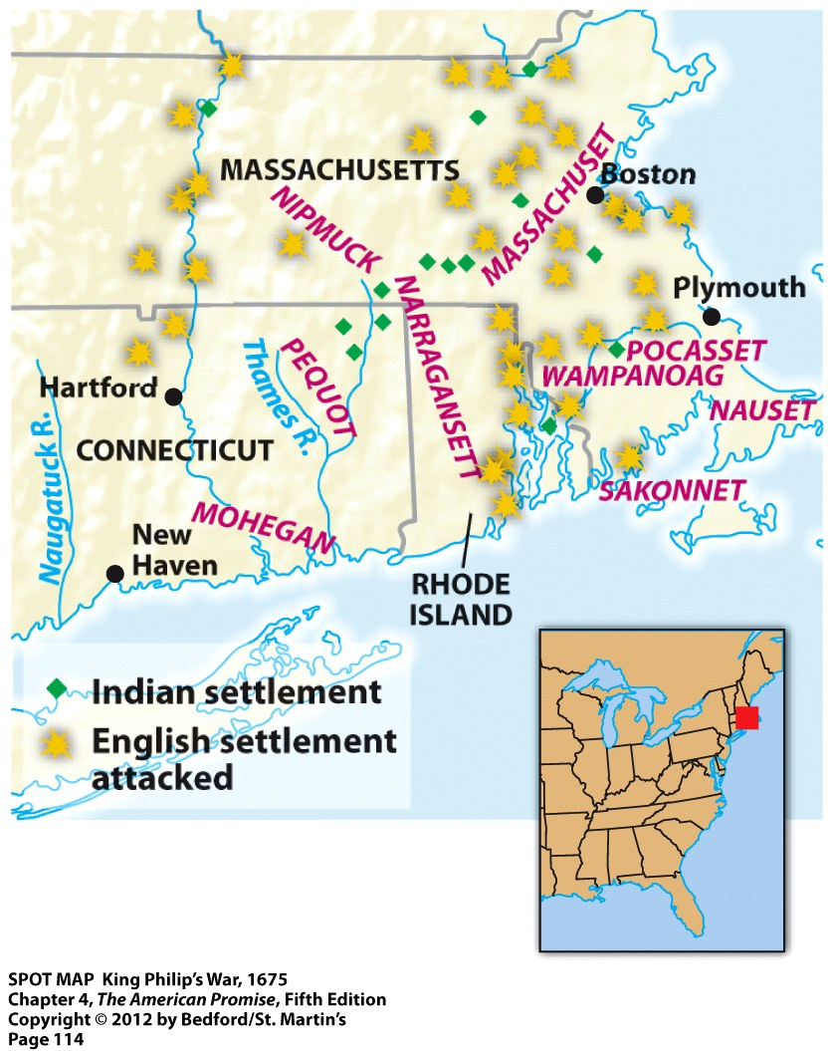
CONFLICTS BETWEEN COLONISTS AND NATIVE AMERICANS

Slide 23
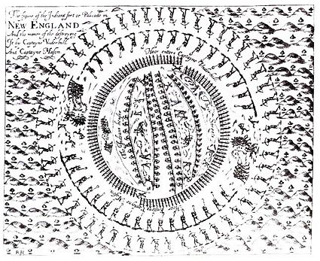
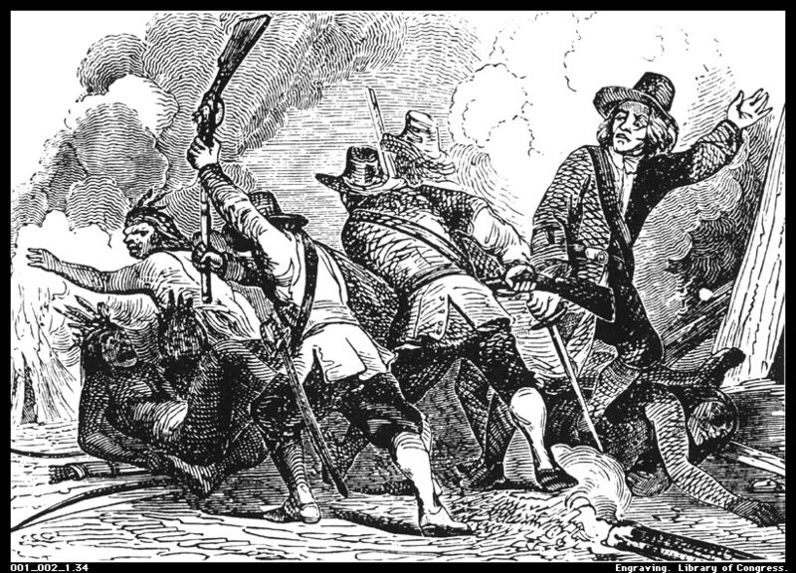
PEQUOT WAR, 1637
Pequot settlement on the Mystic
River, from a 1638 engraving.

Slide 24
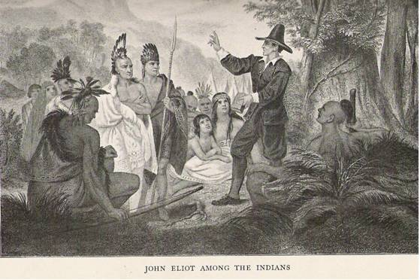
PRAYING VILLAGES, 1651-1675

Slide 25
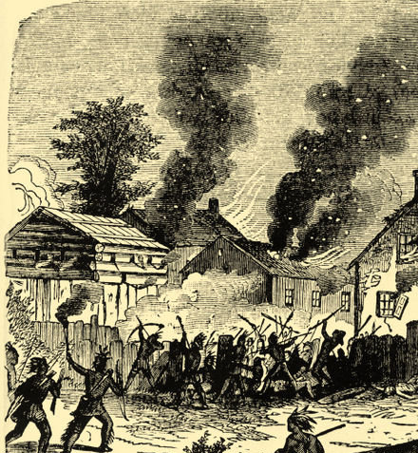
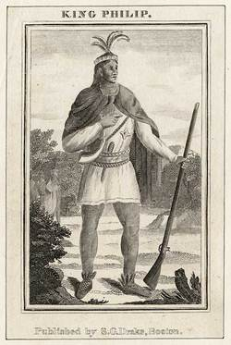

Slide 26
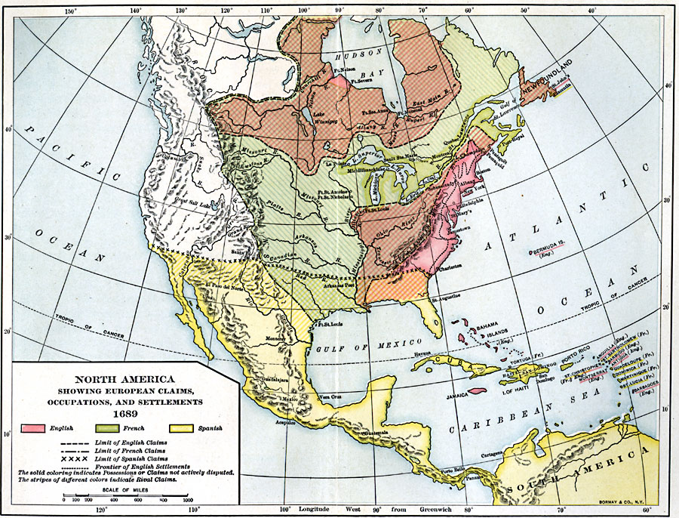
17TH CENTURY NORTH AMERICA
After the European invasions

Slide 27
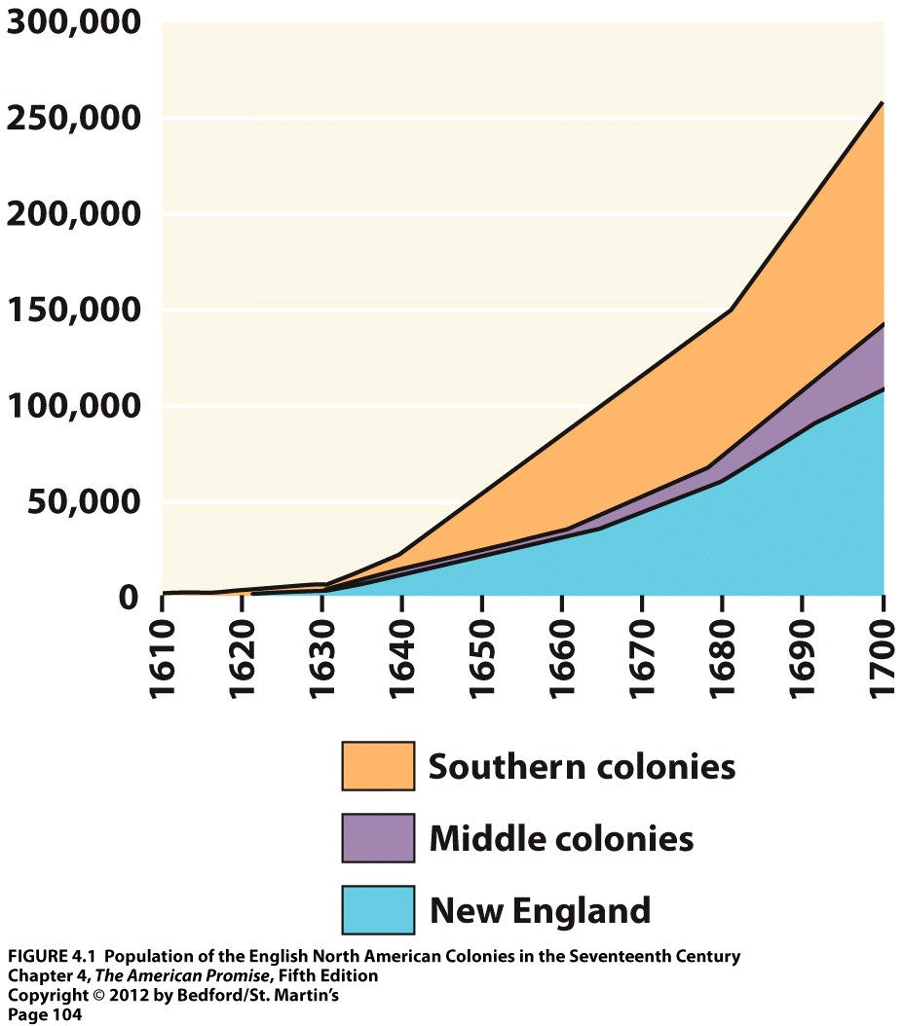

Slide 28
REVIEW FACTUAL QUESTIONS
Be able to match the group of settlers to the colony which they settled
A. Virginia
B. South Carolina
C. Plymouth
D. Massachusetts
E. Pennsylvania
1. Pilgrim Separatists
2. Puritans
3. Quakers
4. Members of a Joint-Stock Corporation
5. Colonists from Barbados

Slide 29
REVIEW FACTUAL QUESTIONS
Be able to match the main economic activity to the colony in which it took place as of the end of the 17th Century
A. Virginia
B. South Carolina
C. New England
D. Pennsylvania
1. Production of rice and indigo
2. Tobacco
3. Diverse economy including shipping and agriculture
4. Agriculture

Slide 30
REVIEW FACTUAL QUESTIONS
Match the colony to the social groups in which colonists arrived during the 17th century
A. Virginia
B. South Carolina
C. New England
D. Pennsylvania
1. Complete families
2. Indentured servants
3. Established landowners from the Caribbean
4. Enslaved people
5. Religious dissidents
(Note: there is more than one answer to each)

Slide 31
REVIEW: FACTUAL QUESTIONS
When talking about commodities produced by indentured servants and slaves, why didn’t your instructor talk much about cotton?
What is the difference between an indentured servant and a slave?

Slide 32
BIG QUESTIONS FOR THE REST OF TODAY
1) What factors (political, economic and traditional sources of authority) held the American colonies in submission to the mother country?
2) Why did those factors begin to break down during the 18th century?
3) How different was “the American” from “the Englishman” by the end of the Revolution?

Slide 33
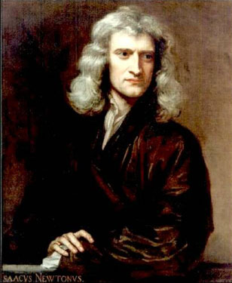
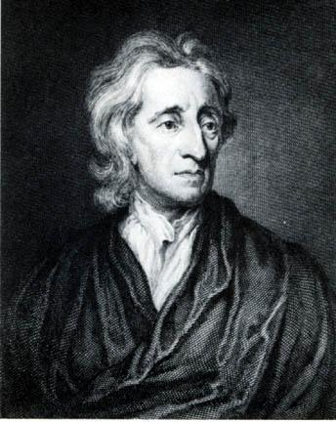
THE EUROPEAN ENLIGHTENMENT
Isaac Newton’s advances in Physics
convinced Europeans that the natural
world could be understood, and
therefore manipulated.
Locke argued that God had granted the ability
to acquire knowledge which he could use to
improve his position.

Slide 34
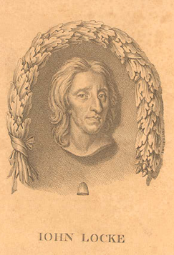
JOHN LOCKE’S SECOND TREATISE OF CIVIL GOVERNMENT (1690)
Argued men have “natural rights” owing to their ability to reason
Government will respect these rights, protect “life liberty and property”
When government is tyrannical people have the right to rebel against it
Have you heard language like this before?

Slide 35
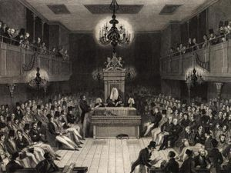
THE RIGHTS OF ENGLISHMEN
The English Bill of Rights guaranteed:
Law is to be made in Parliament
Elections and debate in parliament are free of royal tampering
Judges are to be independent of the crown
Citizens entitled to trial by juries of their peers
Parliament in the 17th Century

Slide 36
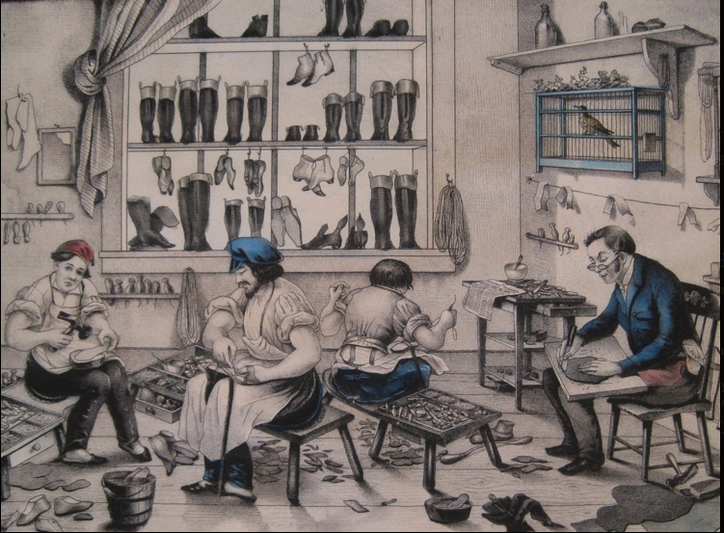
MATERIALISM
Colonists could
buy American-made
goods, but
British merchants
were often willing
to extend credit
to American
colonials…
American shoe-makers during the late-18th century.

Slide 37
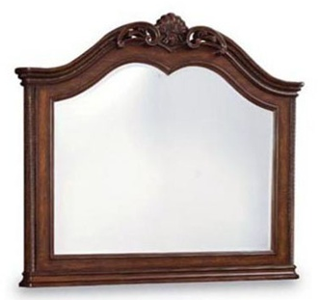
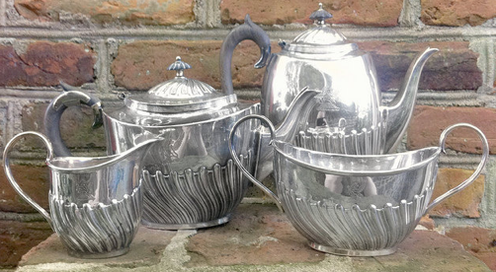
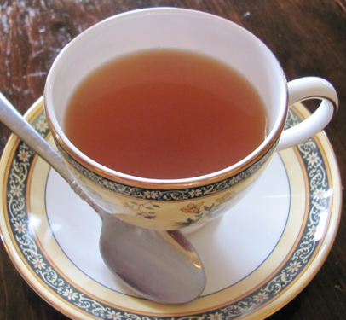
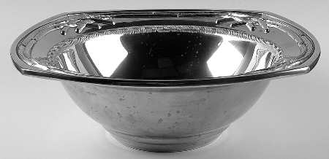
Do British goods make one British?

Slide 38
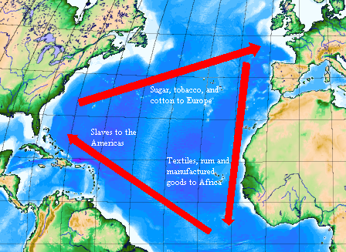
THE ROLE OF THE AMERICAN COLONIES IN BRITISH TRADE
With American colonies a
source of raw materials, only
American elites could
participate in the cultural
construction of “the
Englishman”

Slide 39
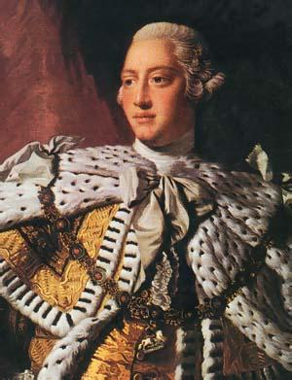
DEFINING MERCANTILISM
His Majesty, King George III, commands you to define mercantilism for your instructor.
He further commands you to consider what mercantilism meant for American colonials infused with the idea that they possess the rights of Englishmen.

Slide 40
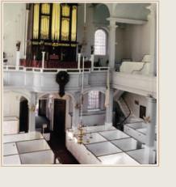
MATERIALISM WITHIN THE ANGLICAN CHURCH
Boston’s Old North Church
Members would have to rent pews. The best seats cost more and were reserved by prominent families.

Slide 41
TWO SCOURGES OF COLONIAL RELIGIOUS LIFE
1. Secularization
17th century – most talented men became clergy
18th century – begin studies as ministers but end up in other professions
i.e. John Adams – starts school as a minister, becomes a lawyer in Boston.
i.e. Benjamin Rush – starts school as a minister, becomes a doctor in Philadelphia.
2. Toleration
End of established churches

Slide 42
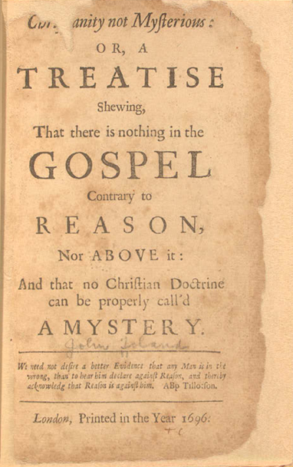
DEISM
Denied active role of God in every-day affairs.
Stressed the role of morality in public actions.
Religious claims must be subjected to reason.
A deist tract by John Toland which found
an audience in the American colonies.

Slide 43
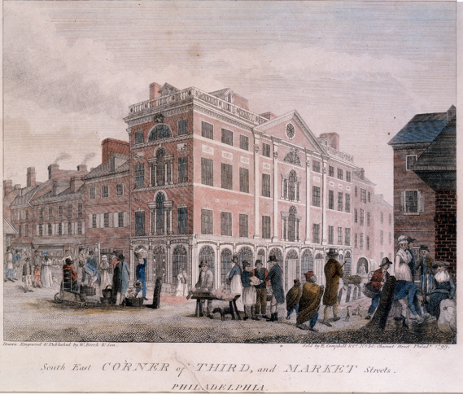
AMERICAN PHILOSOPHICAL ASSOCIATION
Founded in 1769, the American Philosophical Association helped make Philadelphia the center on Enlightenment thought in the colonies.

Slide 44
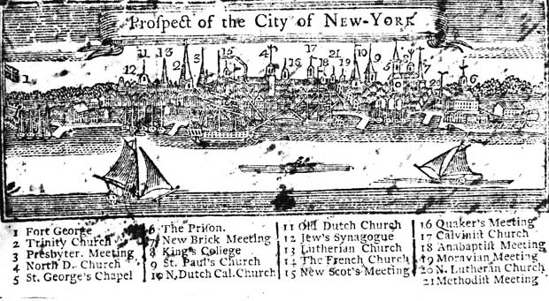

Slide 45
AN APPARENT PARADOX
1) Rising materialism and secularism undermine religious missions of the founders of the colonies.
2) New revival movement, The Great Awakening, restores and reshapes the role of religion in American life.
This paradox sets the stage for the tension about religion that survives in American life today.

Slide 46
THE GREAT AWAKENING
An evangelical movement of the 1740s
Focused on the conversion of listeners
First religious movement to echo throughout the thirteen colonies
Revival meetings
Large scale, intensely emotional

Slide 47
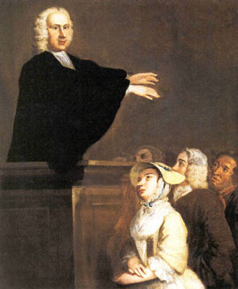
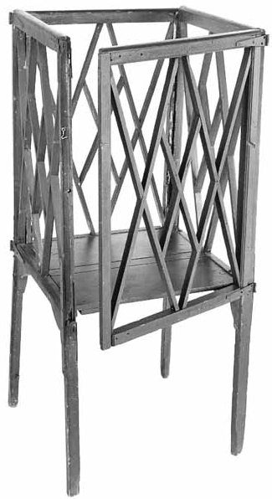
GEORGE WHITEFIELD

Slide 48
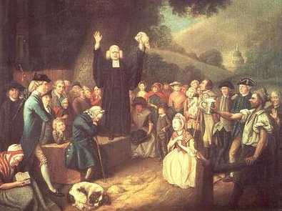
GEORGE WHITEFIELD

Slide 49
AFTERMATH OF THE GREAT AWAKENING
1. Refreshed the spiritual energy of the colonies
2. Split established churches
New sects: Presbyterians, Methodists, Baptists
3. Weakened authority and status of the clergy
4. Injected strain of egalitarianism into American life
5. Injects emotionalism (even anti-intellectualism) into American life
6. Creates a common set of experiences that bound the more secularly minded

Slide 50
COLONIAL GOVERNMENTS
Rule of Monarchy = despotism
Rule of Elite = oligarchy
Rule of People = mob rule
Enlightenment thinkers suggest balance of powers.
Concentrated powers are the enemy of liberty

Slide 51
STRUCTURE OF COLONIAL GOVERNMENT
Colonial governor – appt by king – power of the monarchy
Colonial council – appt by governor – power of the elite
Colonial assembly – elected by men of property – power of the people
Governors of poor quality allow powers to devolve to the assembly, particularly the “power of the purse”
By 1720s, assemblies have won the power to initiate legislation-- includes tax laws and the spending of public funds.

Slide 52
“THE RIGHTS OF ENGLISHMEN”
What do you think the phrase “The Rights of Englishmen” meant to England’s American colonists in the 18th century?

Slide 53
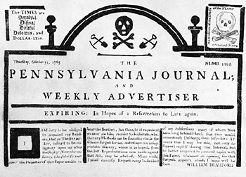
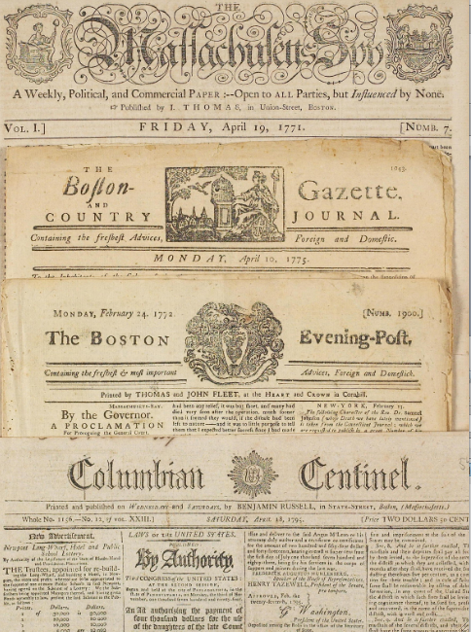
WHIG IDEOLOGY
Idea that liberty must be guarded by citizens who are active and aware.
Helped by the proliferation of newspapers in the colonies.

Slide 54
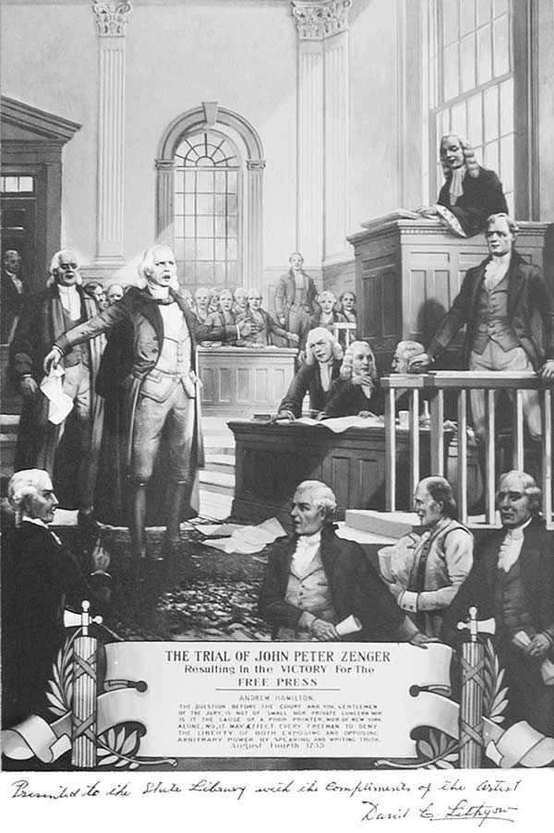
ZENGER LIBEL TRIAL (1735)
Center on attacks by John Peter Zenger’s New York Weekly Journal on Governor William Cosby
Zenger acquitted in libel case in 1735

Slide 55


BOSTON IMPRESSMENT RIOT OF 1747
Commodore Charles Knowles
20th century image of impressment

Slide 56
REVIEW: BROAD QUESTIONS
How did the relationship between Britain and her American colonies change during the 18th century?
How would you explain some of those changes?

Slide 57
NEXT TIME:
The Long American Revolution
Next time we will examine the creation of an American republic out of 13 British North American colonies.
Required readings: Roark chapter 6 (all), chapter 7 (157-164)

Slide 58
REVIEW TERMS:
Puritans
Pilgrim separatists
Mayflower Compact
John Winthrop’s “City On a Hill” speech
Quakers
William Penn
King Philip’s War
Glorious Revolution of 1688
John Locke
English Bill of Rights
George Whitefield
Whig Ideology
the “power of the purse” Materialism
Deism
The Great Awakening
“tyranny”/concentrated powers

